Slide 1


Slide 2

Table of Contents

Slide 3
Problem Statement:
An automobile parts manufacturing company has collected data of transactions for 3 years. They do not have any in-house data science team, thus they have hired you as their consultant. Our job is to use our magical data science skills to provide them with suitable insights about their data and their customers.
Data Dictionary
Data Dictionary:
ORDERNUMBER : | Order Number | CUSTOMERNAME : | customer
QUANTITYORDERED : | Quantity ordered | PHONE : | Phone of the customer
PRICEEACH : | Price of Each item | ADDRESSLINE1 : | Address of customer
ORDERLINENUMBER : | order line | CITY : | City of customer
SALES : | Sales amount | POSTALCODE : | Postal Code of customer
ORDERDATE : | Order Date | COUNTRY : | Country customer
DAYS_SINCE_LASTORDER : | Days_ Since_Lastorder | CONTACTLASTNAME : | Contact person customer
STATUS : | Status of order like Shipped or not | CONTACTFIRSTNAME : | Contact person customer
PRODUCTLINE : | Product line – CATEGORY | DEALSIZE : | Size of the deal based on Quantity and Item Price
MSRP : | Manufacturer's Suggested Retail Price
PRODUCTCODE : | Code of Product

Slide 4
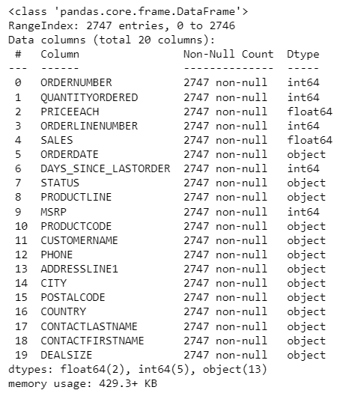
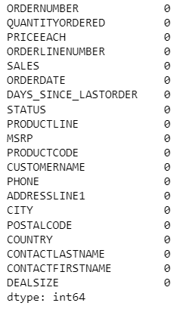
Inferences:
The data has 2747 rows and 20 columns with the below headings. The data can be seen having 2 float type categories , 5 integers and 13 object type data.
The data has no duplicates and each column has unique data.
There are no null values in the data as well.

Slide 5
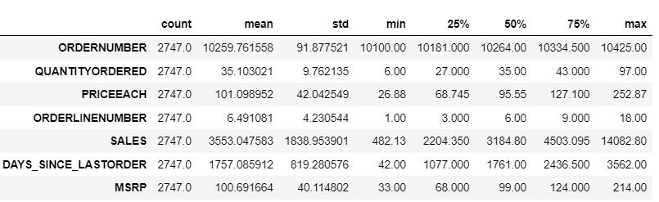
Exploratory Data Analysis
Inferences:
The data has count of 2747 which confirms no missing values.
The highest mean is for order number which is a unique field to differentiate orders placed. Considering sales our target we see it has a mean of 3553.05 and minimum value of 482.13 which indicates we need to check outliers. The difference is high and we need to investigate the same.
Quantity ordered seems to be having good numbers with minimum order of 6 and maximum 97. Price and days since last order also seem to be inline without much difference with less difference in minimum and maximum values.
MSRP(Manufactures suggested retail price) also seem to be having a healthy difference between mean and maximum values.
Product Line | Count of Products sold
Classic Cars | 949
Vintage Cars | 579
Motorcycles | 313
Planes | 304
Trucks and Buses | 295
Ships | 230
Trains | 77
Grand Total | 2747
The maximum cars sold is classic cars and the least is Trains.

Slide 6
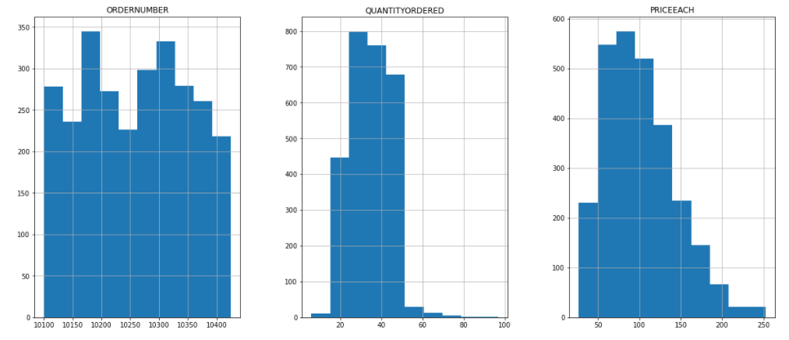
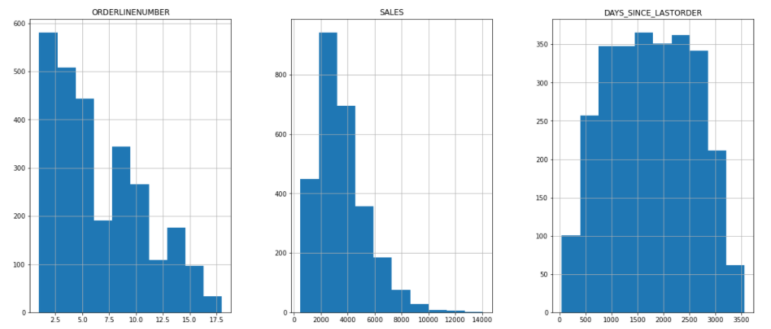
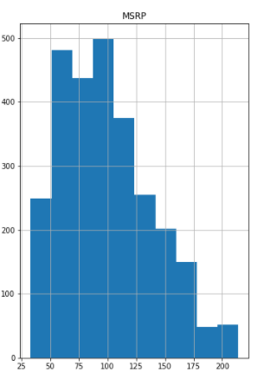
Univariate Analysis
Inference:
Again order number being unique identification number for customer order we see it’s the highest in the range if 10150-10200. The highest sales is for order#10407 .
The quantity ordered is the highest in the range of 20-30. Individually quantity 70 has the highest sales.
Since the data is a summarised representation maximum price is 50-100. The highest sales has been for Rs. 185.3.
The order line number has the highest range from 2.5-5. 2 having the highest sales.
Sales has been the maximum in the range 2000-4000.
Days since last order is uniformly distributed dated. Maximum lag being 2000-3000 slab.
The MSRP is maximum at 100. The lowest price set by the retailer is at 175-200.
Inferences:

Slide 7
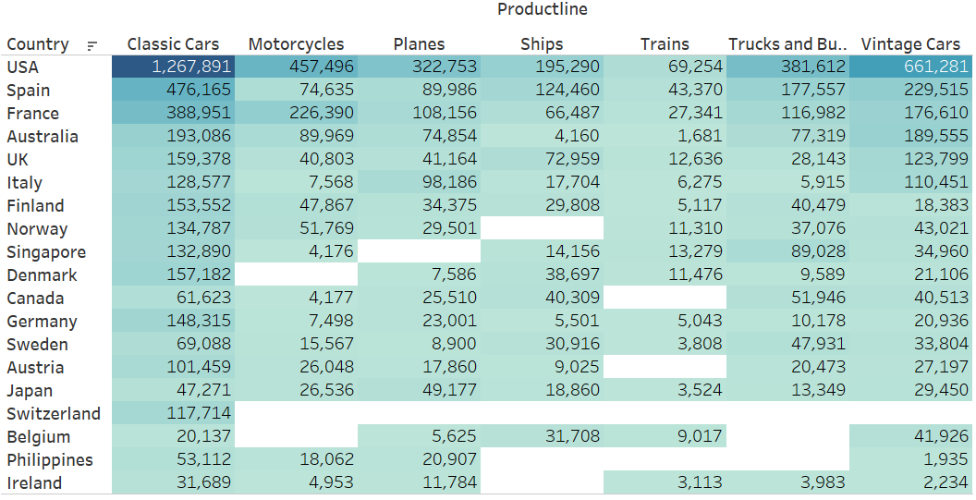
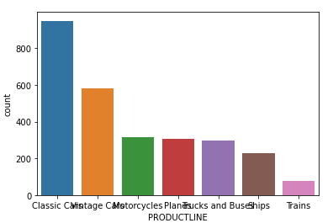
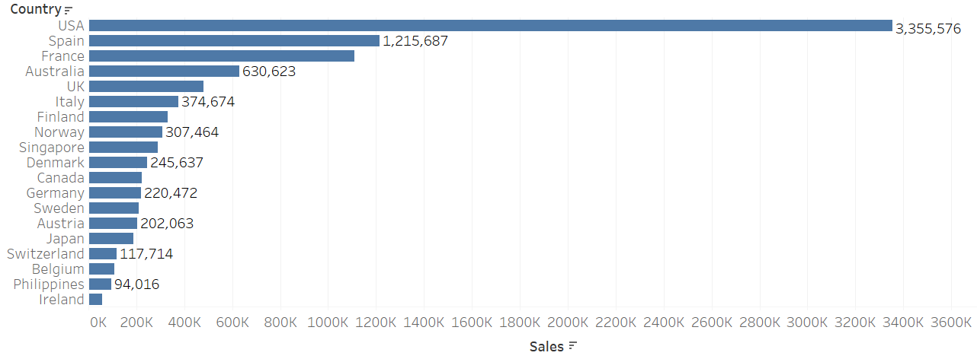
Bivariate and Multivariate Analysis
Inference:
Country wise product line we see sales is the highest for USA and lowest for Ireland.
The maximum sales is of Classic Cars , second being vintage cars and the minimum is of Trains.

Slide 8
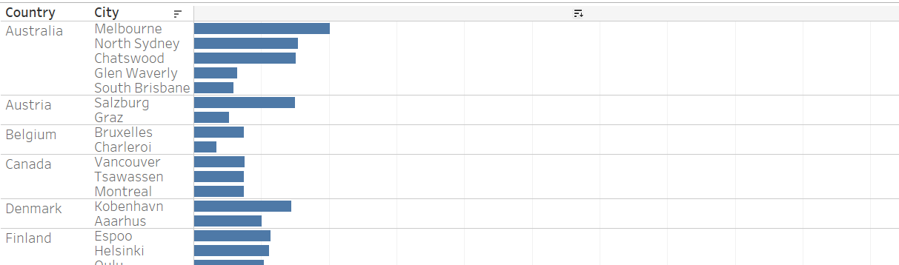
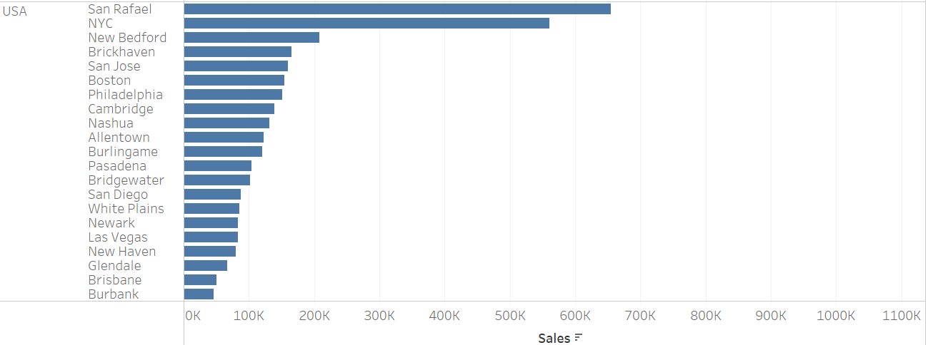
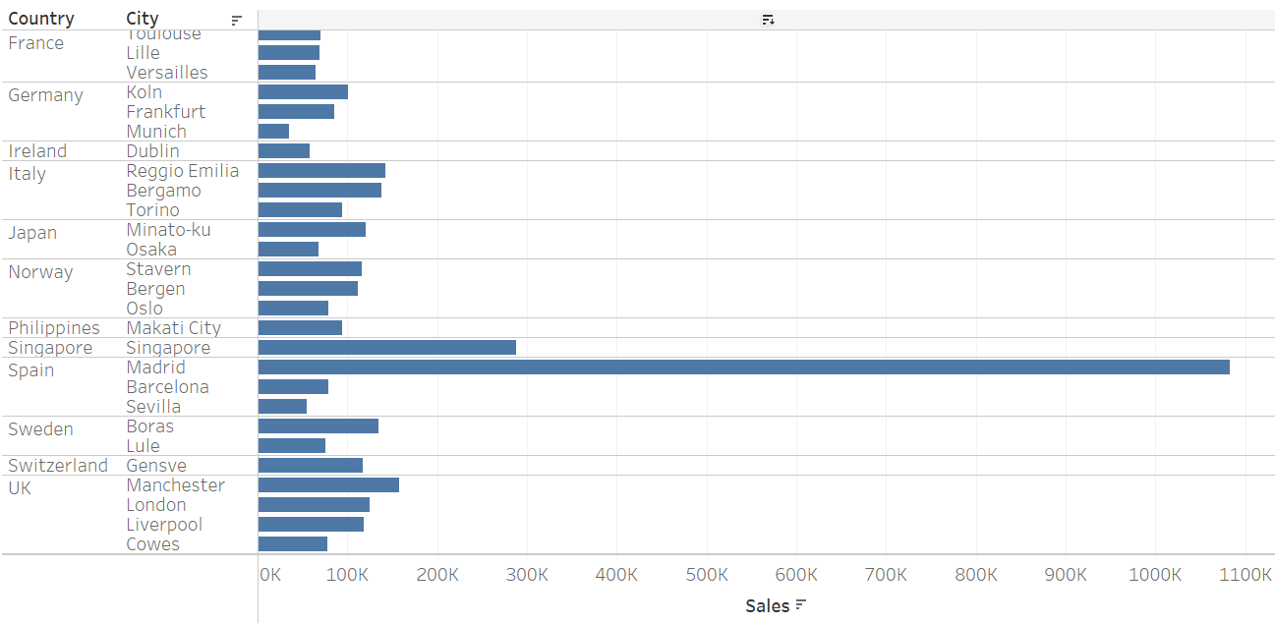
Sales Analysis with different parameters:
Country to City wise sales.
Inference:
Highest sales is in the USA in the city San Rafael.
Lowest is in France in the city Nantes.
There is a total of 71 cities in the data.
Dimensions
City has 71 members on this sheet
Members: Aaarhus; Cambridge; Liverpool; Osaka; San Jose; ...
Country has 19 members on this sheet
Members: Denmark; France; Japan; UK; USA; ...
Measures
Sum of Sales ranges from 33,440 to 1,082,551 on this sheet.

Slide 9
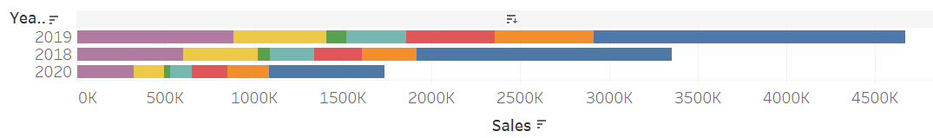
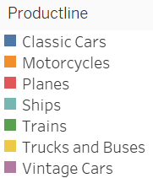
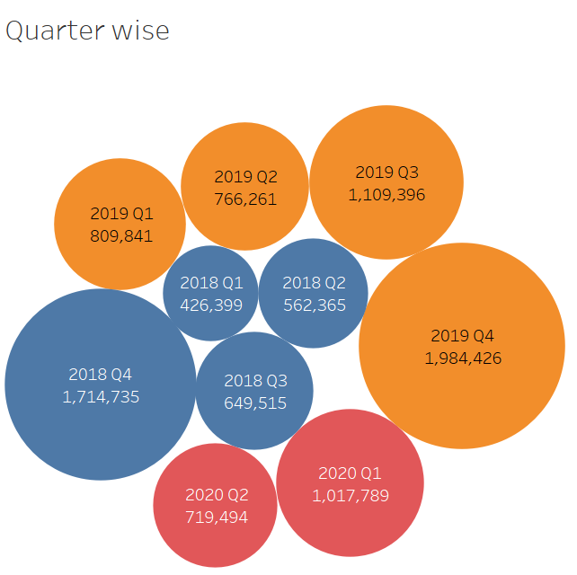
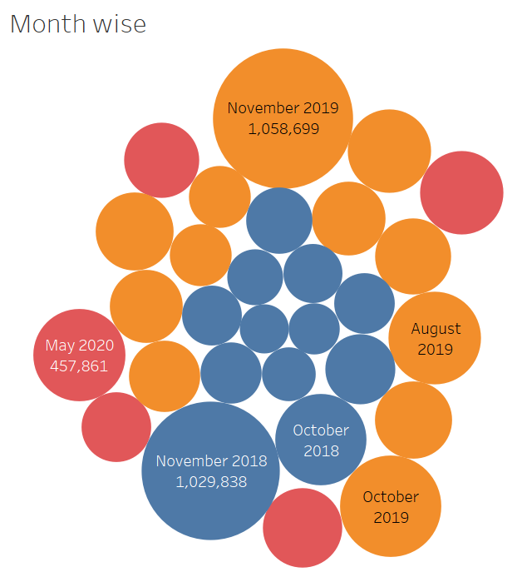
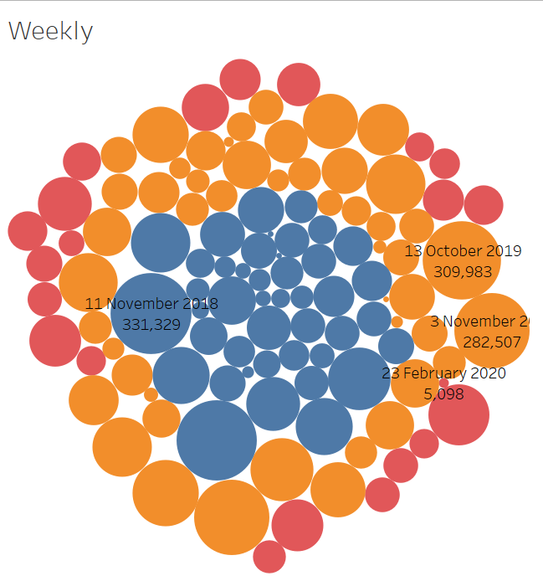
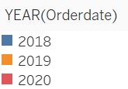
Yearly-Quarterly-Monthly-Weekly wise sales.

Slide 10
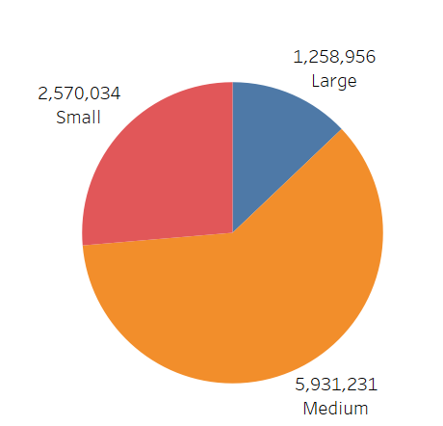
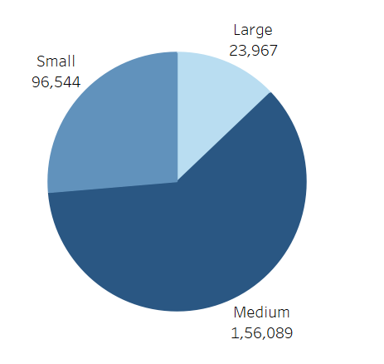
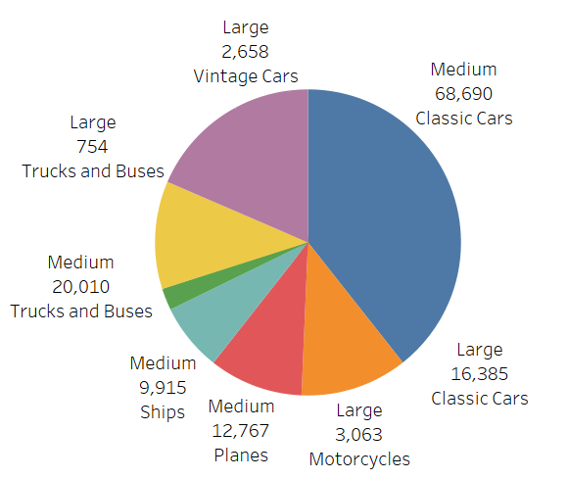
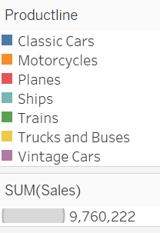
Inference:
Sales is the maximum in the year 2019 for classic cars.
Data represents and confirms classic cars being more in demand and least being trains.
Quarterly sales is highest in Q4 which is year 2019.
The data shows month wise October and November 2019 has the highest sales and lowest is January 2018.
Weekly we see 13th October 2019 having highest sales and lowest being 2nd June 2019.
Sales with deal size and manufactures suggested retail price.
Inference:
We see that deal size medium has maximum sales and the price that manufactures decided is also the maximum for medium size deal.
We in the third figure that the classic cars had the maximum retail price as well as the maximum deal size. Least being deal size large for trucks and buses.
Order Size-Sales
Order Size-MSRP
Order Size-MSRP /Sales

Slide 11
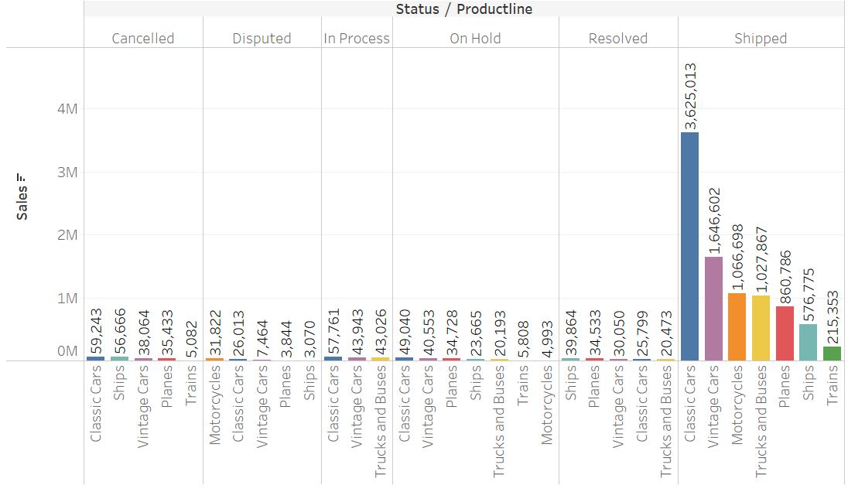
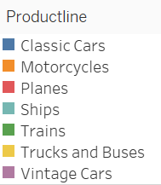
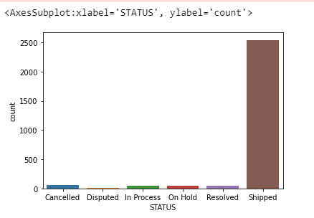
Sales with product status and productline
Inference:
We see that maximum status of the product is shipped. Resolved is of a lesser value than cancelled and disputed which will be analyzed further.

Slide 12
Checking outliers

